Slide 1
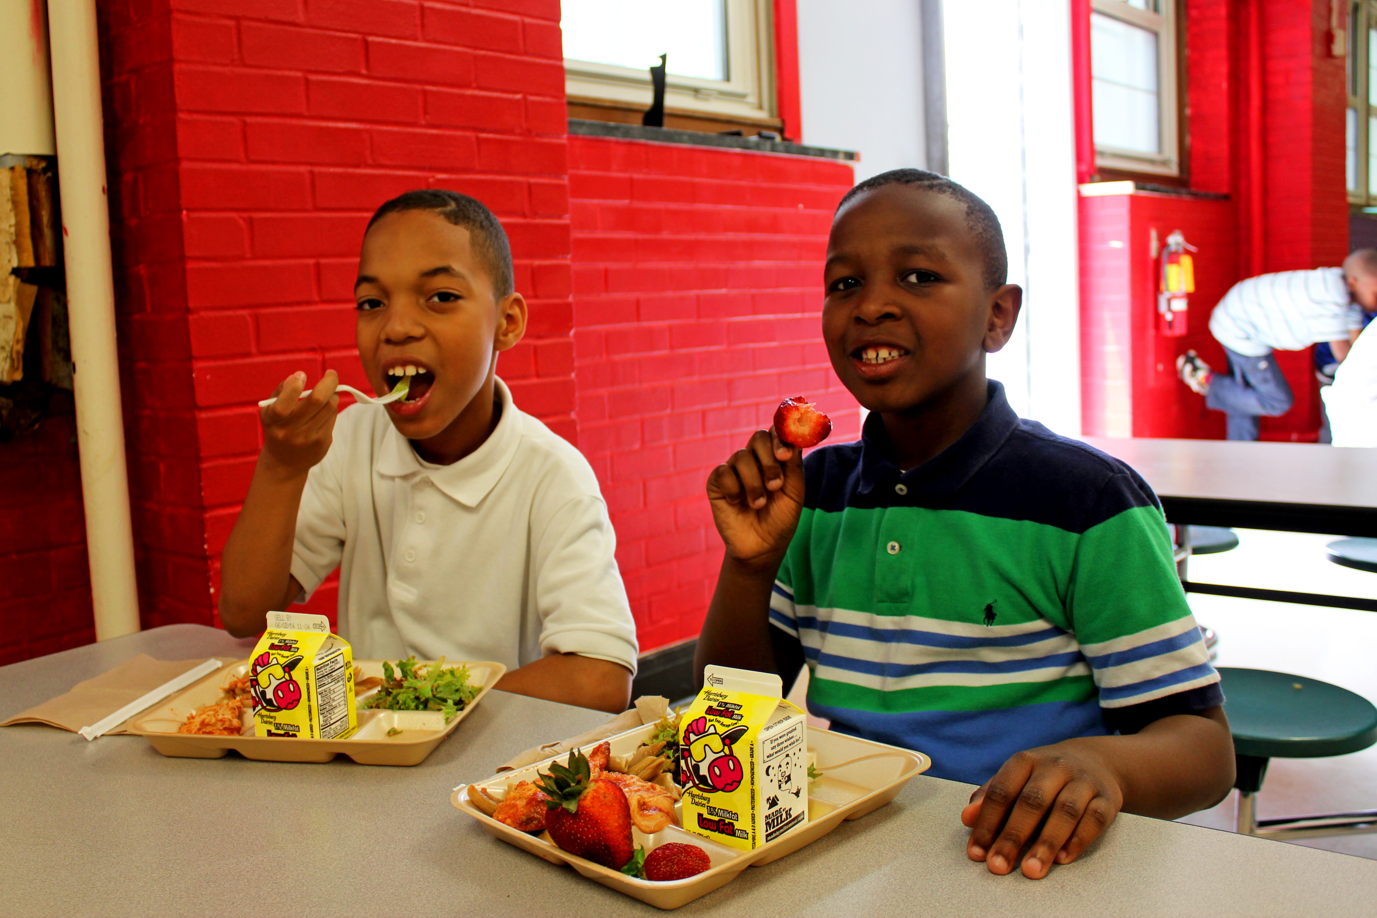
https://www.flickr.com/photos/usdagov/15844937015/sizes/o/
Notes:
Nov 17 - CN - DC - Strawberries 2
USDAgov
https://www.flickr.com/photos/usdagov/15844937015/sizes/o/

Slide 2
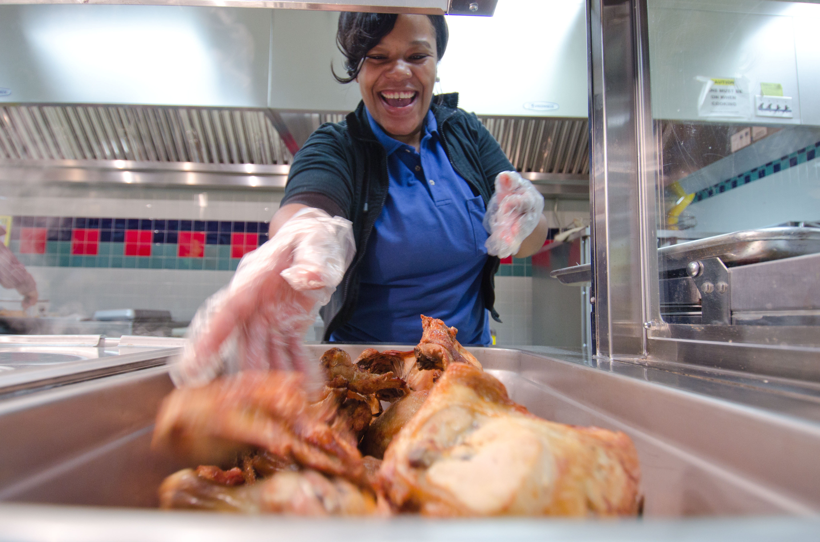
Notes:
20111012-FNCS-LSC-0260 by USDepartment of Agriculture
https://www.flickr.com/photos/usdagov/6239460604/sizes/o/
Nov 17 - CN - DC - Strawberries 2 by USDepartment of Agriculture
https://www.flickr.com/photos/usdagov/15844937015/sizes/o/

Slide 3


Slide 4
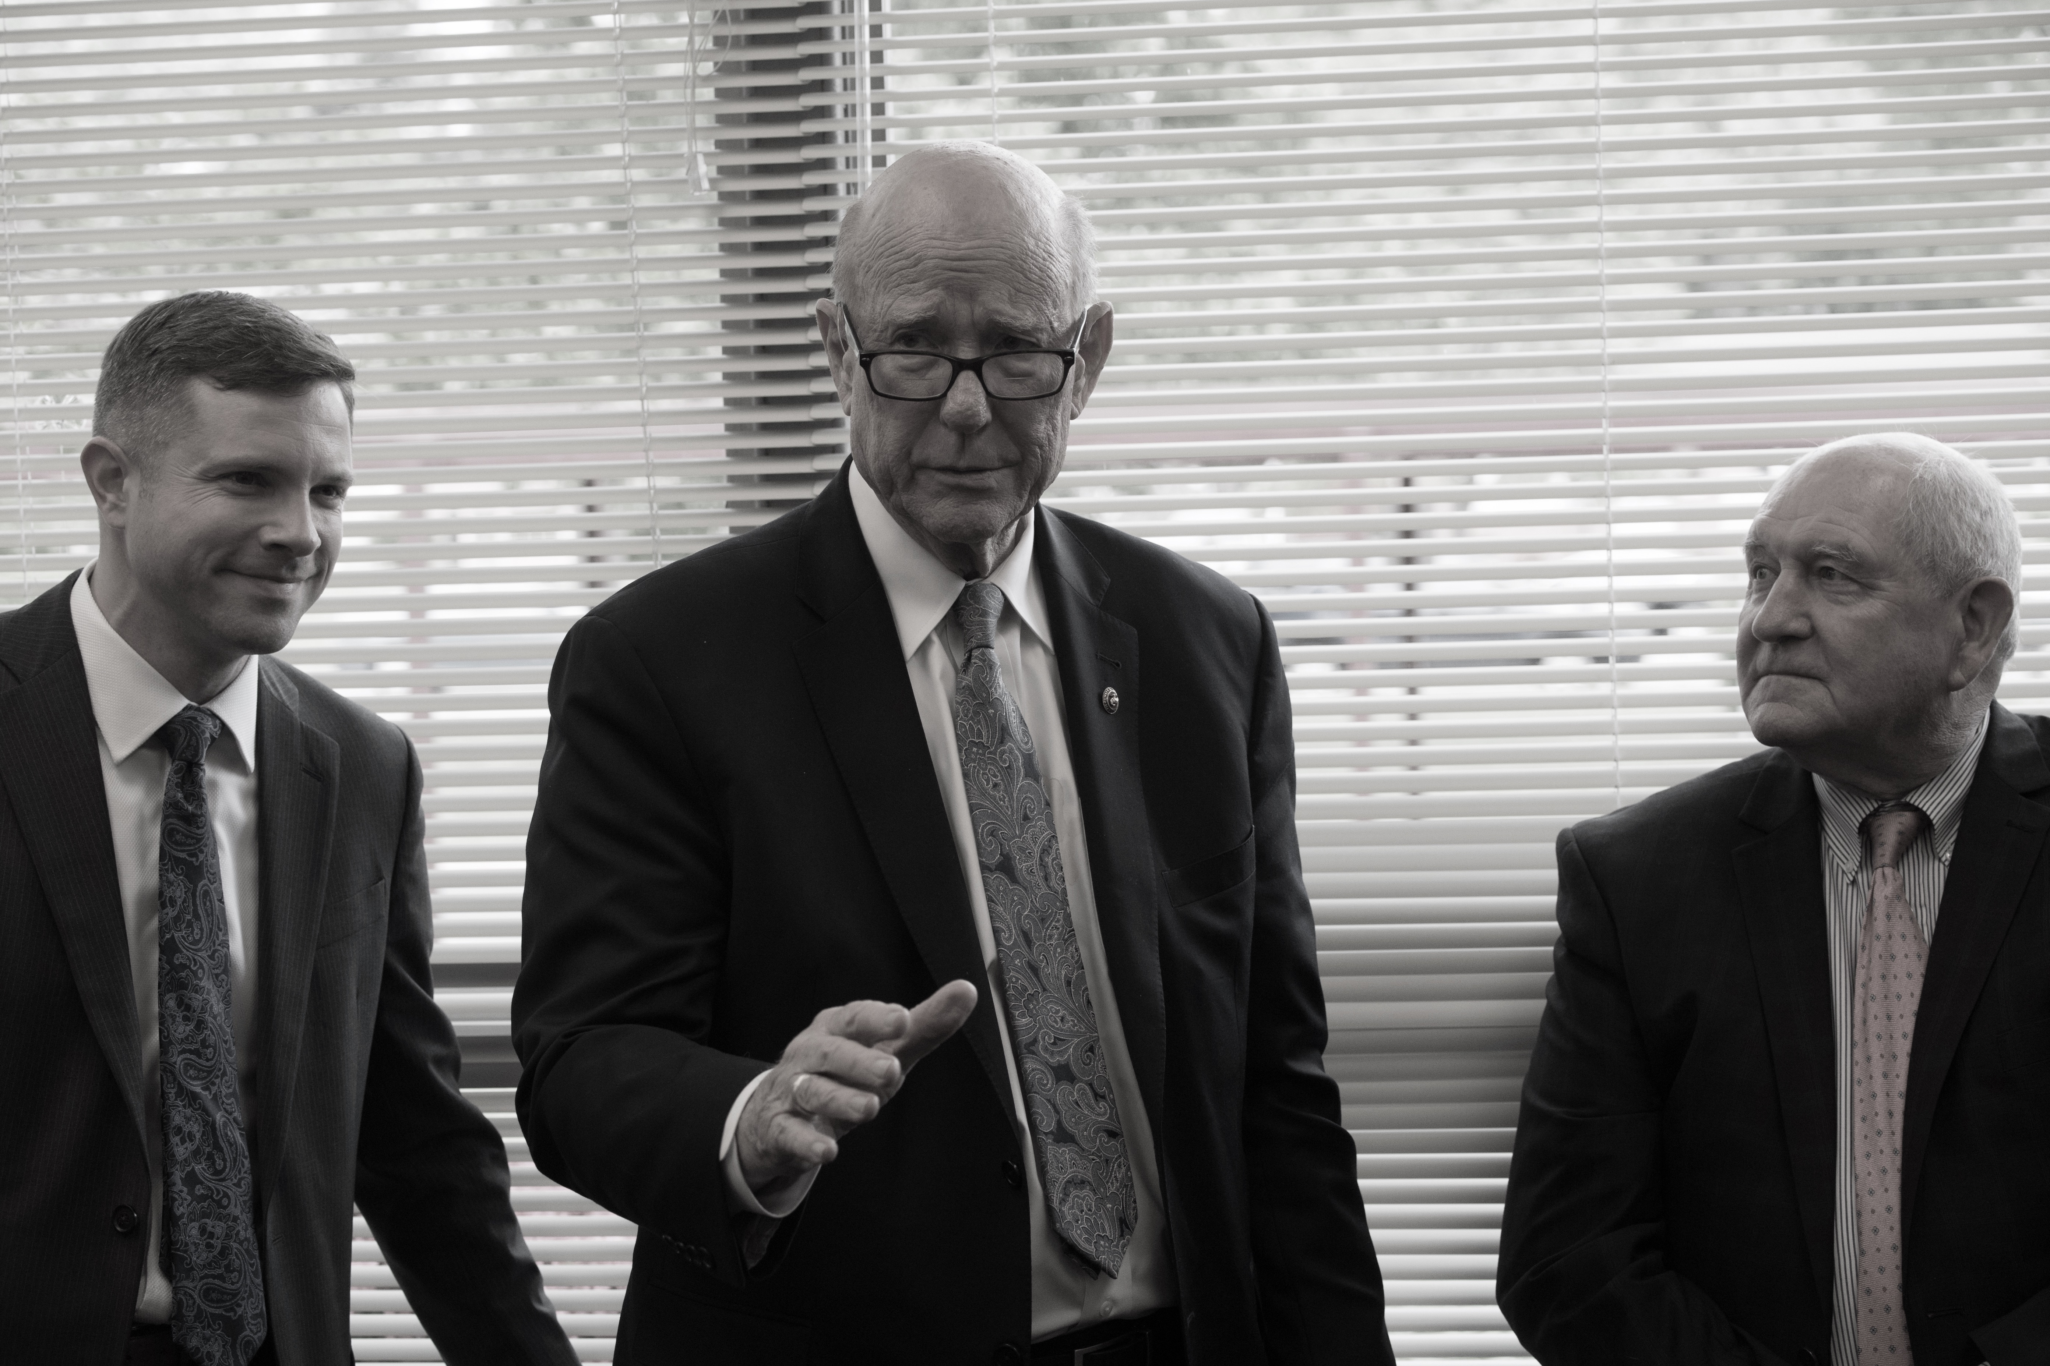

Slide 5
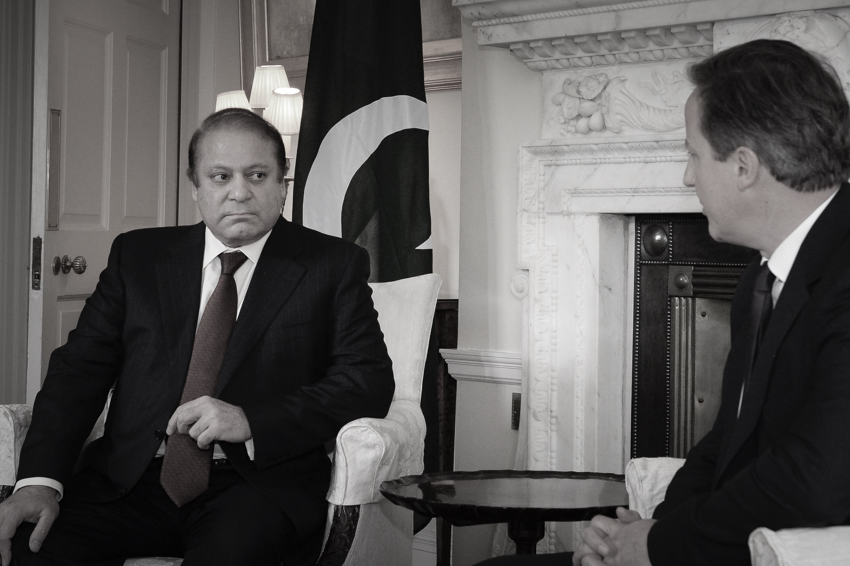

Slide 6
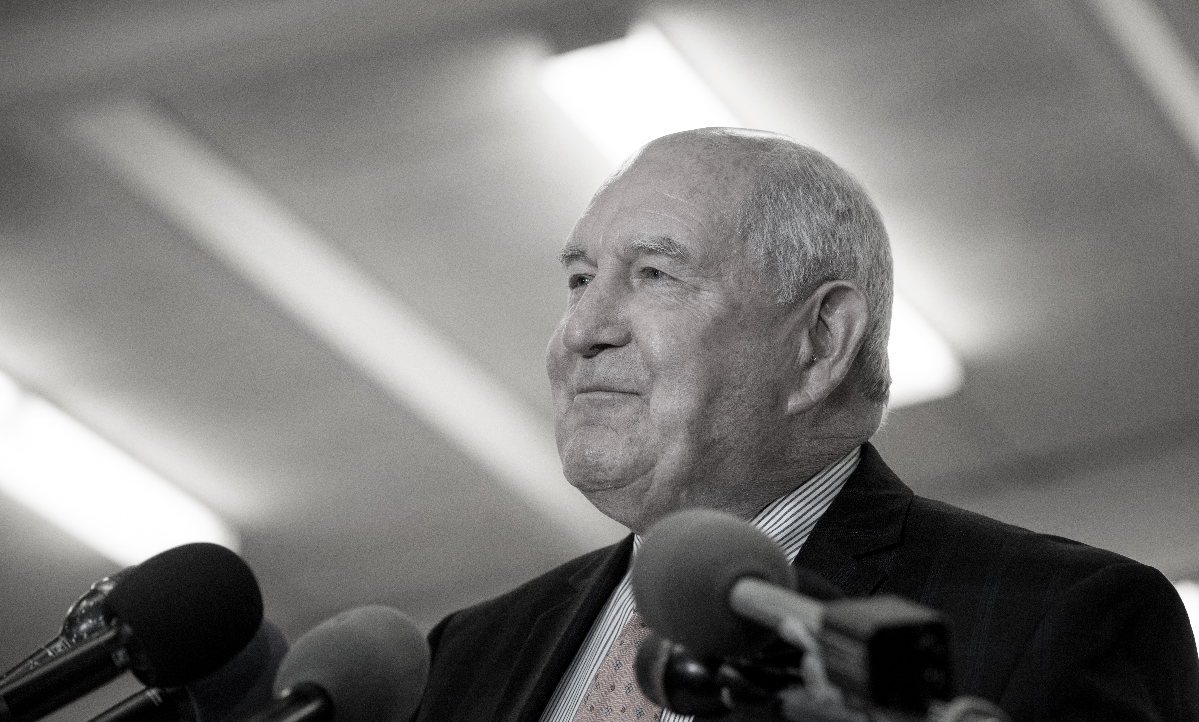
Notes:
Sunny Perdue
USDAgov
Original

Slide 7
PDF The Robust Way

Slide 8
Overview
PDF is Data
Complexity
Workflow
Libraries
Criteria
Tika
PDFBox
PDFTabExtract
Other
Examples
Panama Papers

Slide 9
PDF is data
All data is an input
Humans, The printed page
Assistive Technology

Slide 10
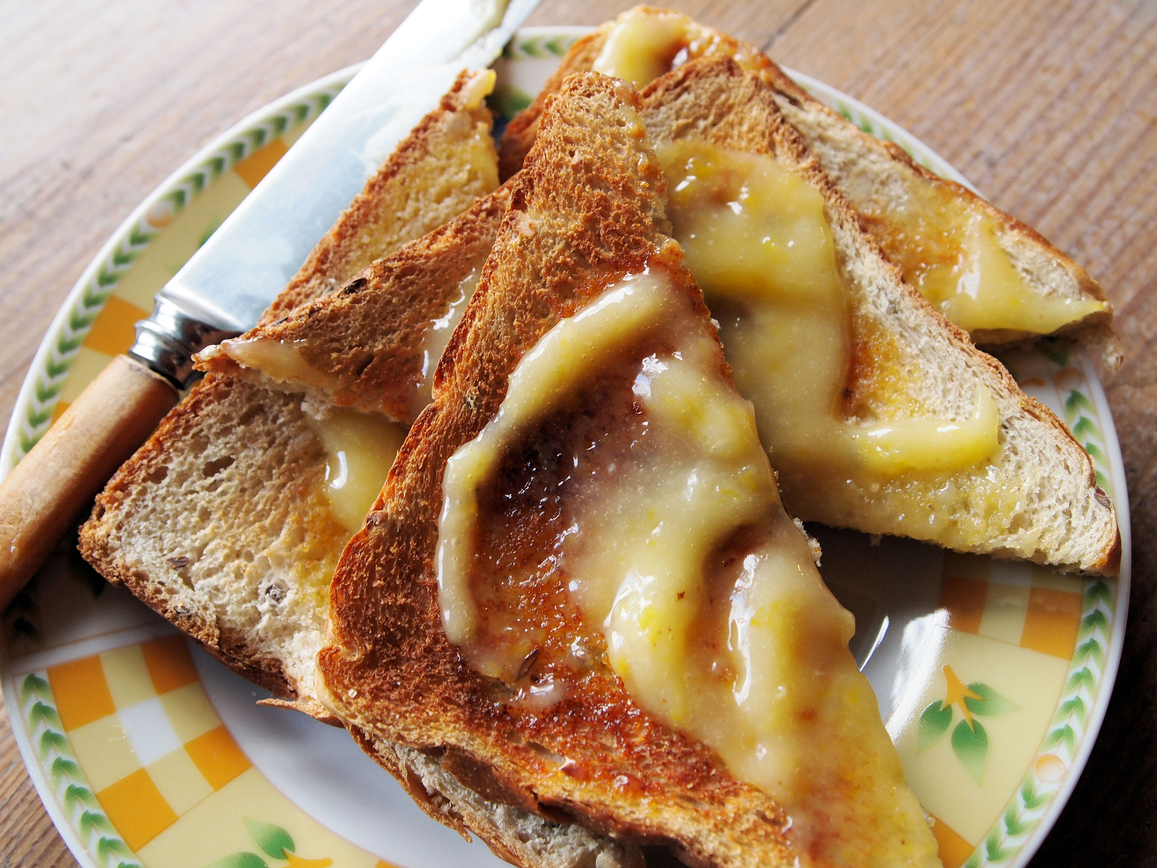
https://www.flickr.com/photos/frenchtart/5483255768/sizes/l
Notes:
https://www.flickr.com/photos/frenchtart/
https://www.flickr.com/photos/frenchtart/5483255768/sizes/l

Slide 11
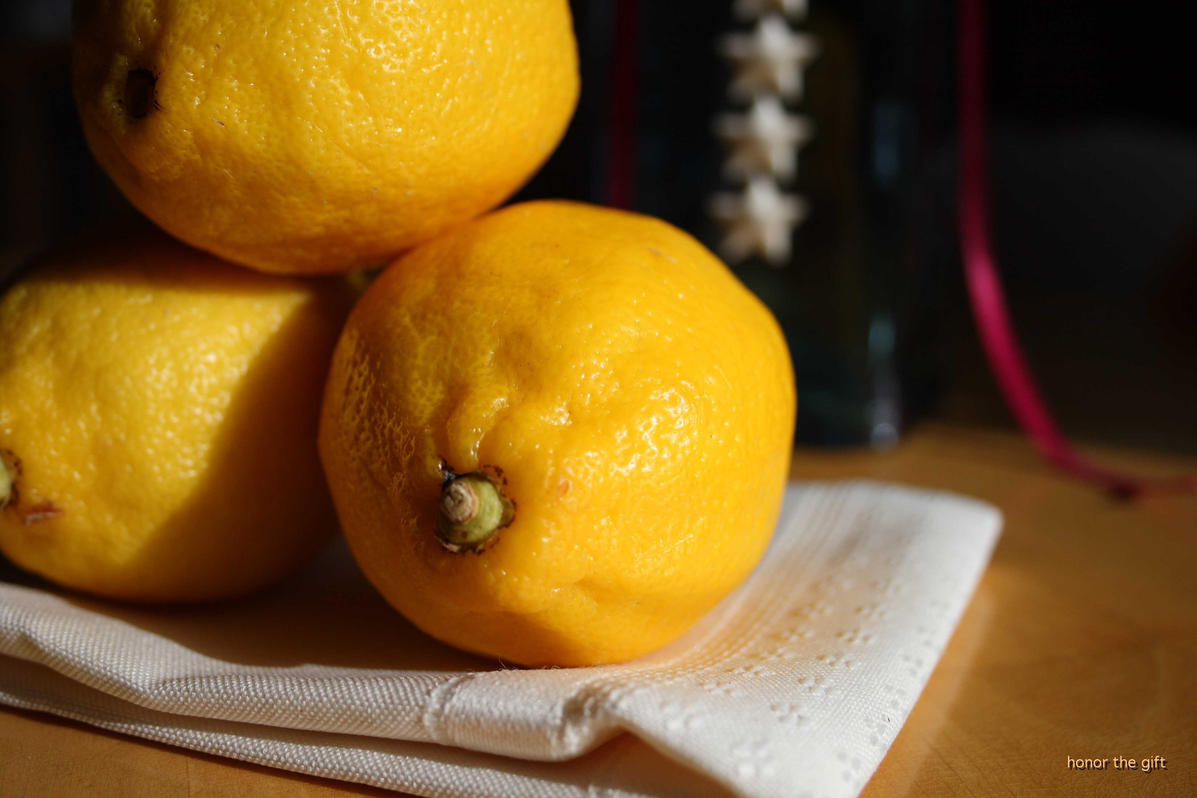
https://www.flickr.com/photos/honorthegift/5080575540/sizes/o/
Notes:
Lemon
honor the gift
https://www.flickr.com/photos/honorthegift/5080575540/sizes/o/

Slide 12
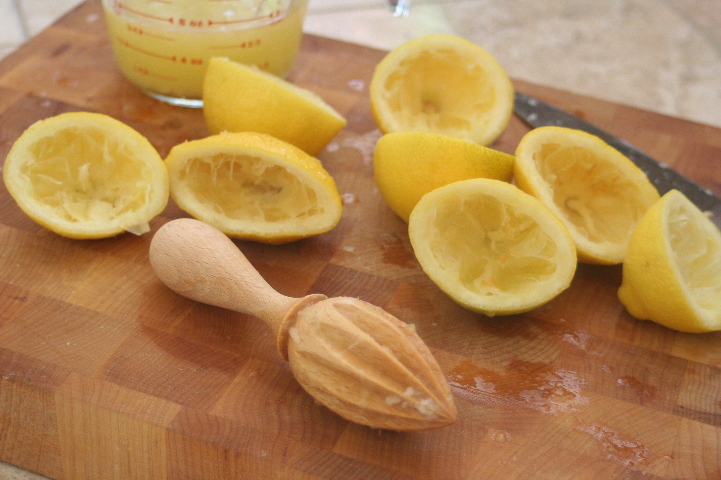

Slide 13
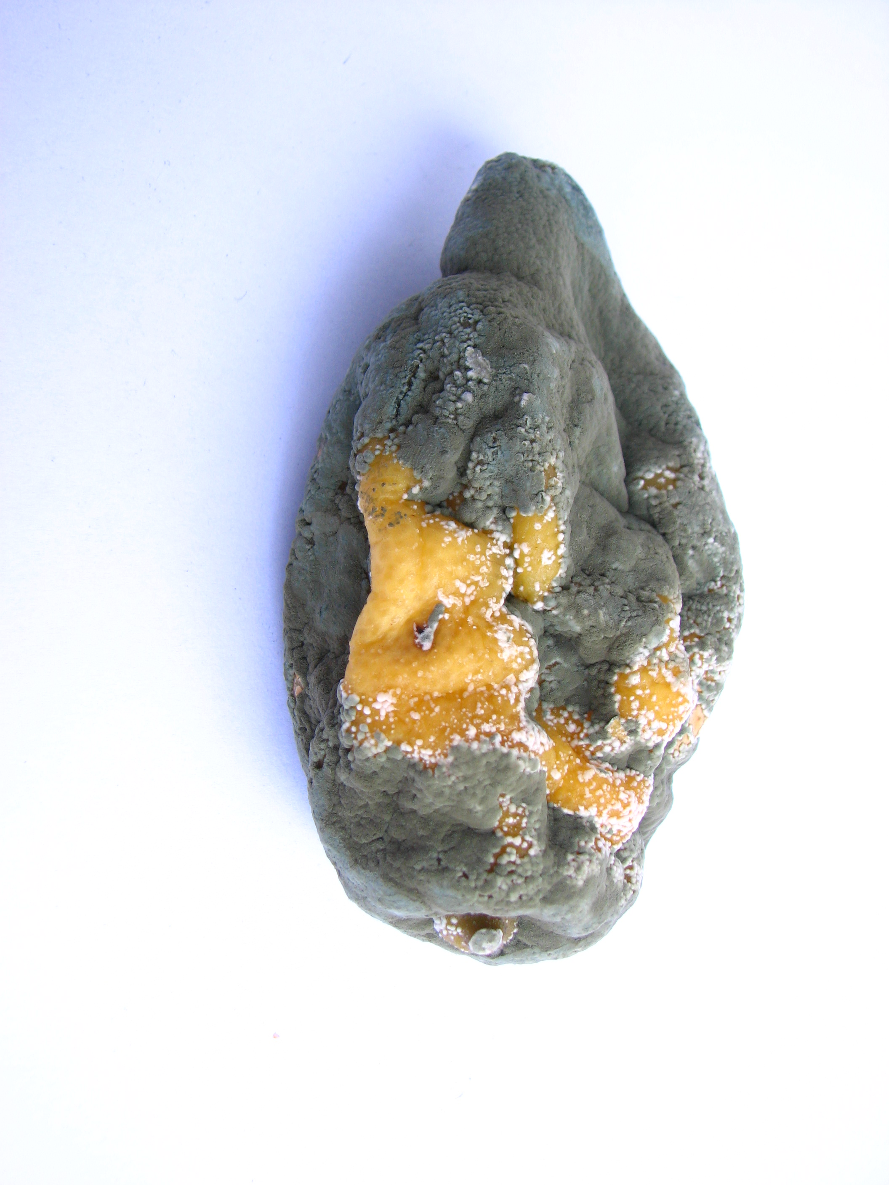
https://www.flickr.com/photos/lute3d/614142045/sizes/o/
Notes:
Manuel Barroso Parejo
https://www.flickr.com/photos/lute3d/614142045/sizes/o/

Slide 14
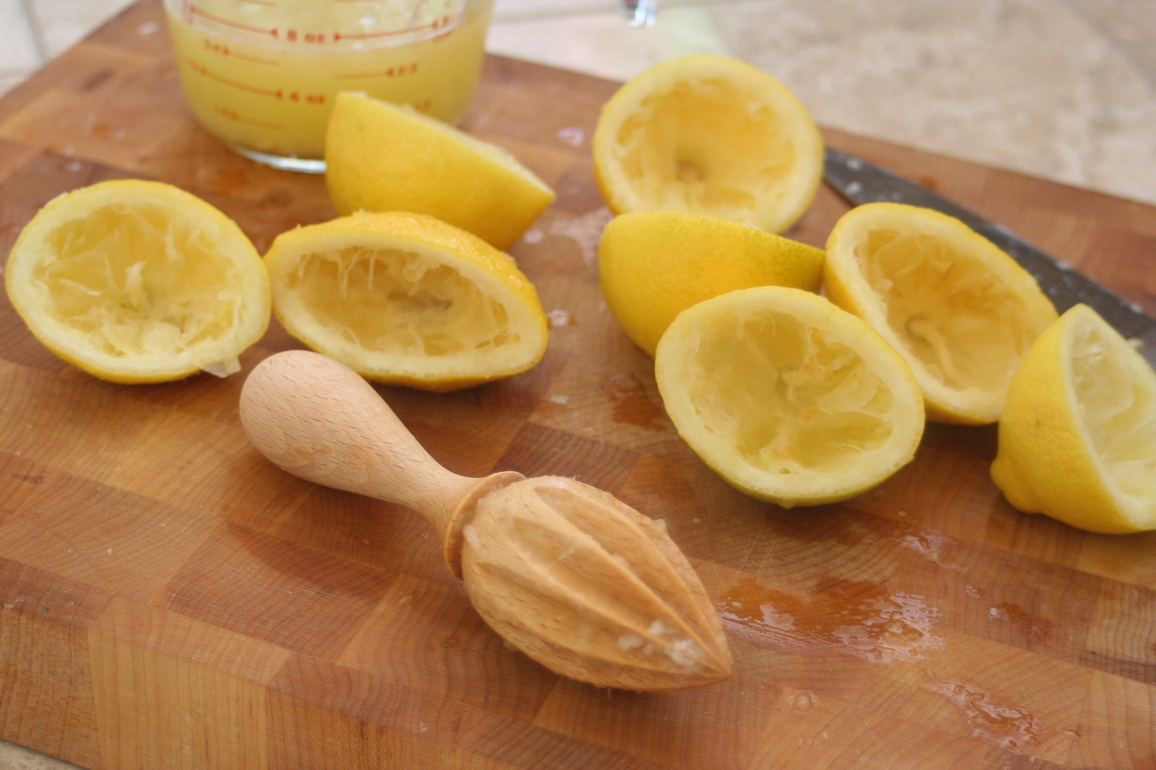
Library Evaluation

Slide 15
Complexity
Low
Just Plain Text
It should still be readable without modification
This may still need editing
Nice for making text searchable
Medium
Images and Text
Grids or Tabular
Sections are in vertical Blocks/Formatting affects meaning little
High
Scanned Text
Labeled data needs to be paired with values

Slide 16
Workflow
Human
Qualitative
Traditional journalist, manager with department reports
Batches, no updates
Printed copies
Machine
Quantitative
Data pipeline for a data product
Large initial input, Updates, Streams
No printing

Slide 17
TIKA

Slide 19
Apache Tika
Evaluation - Great
Complexity - Simple
Human or Machine – Either
Documentation – Good, the maintainer very responsive

Slide 20
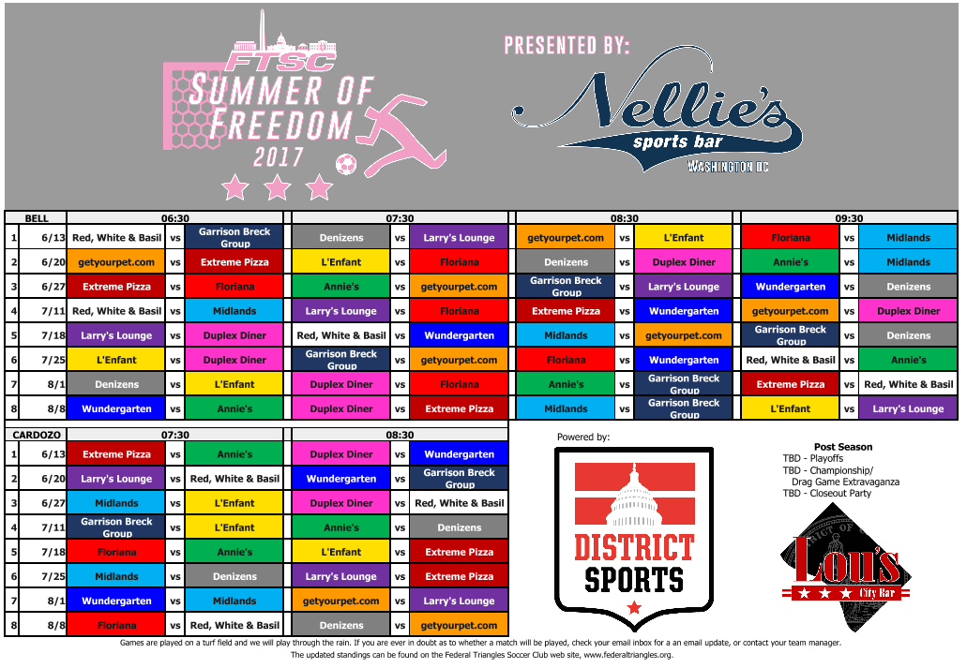
Notes:
A schedule.
Visually appealing
Orderly, yet
Humans fill in the semantic inconsistencies
Document created in Excel

Slide 21
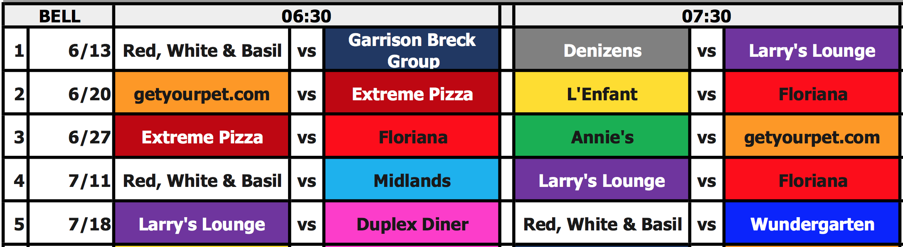

Slide 22
Show Some Code
Import Tika
Get a Parser
Grab the metadata
Grab the Text

Slide 23
Illustrative Text!
1 6/13 Red, White & Basil vs Garrison Breck Group Denizens vs Larry's Lounge getyourpet.com vs L'Enfant Floriana vs Midlands
2 6/20 getyourpet.com vs Extreme Pizza L'Enfant vs Floriana Denizens vs Duplex Diner Annie's vs Midlands
3 6/27 Extreme Pizza vs Floriana Annie's vs getyourpet.com Garrison Breck Group vs Larry's Lounge Wundergarten vs Denizens
4 7/11 Red, White & Basil vs Midlands Larry's Lounge vs Floriana Extreme Pizza vs Wundergarten getyourpet.com vs Duplex Diner
5 7/18 Larry's Lounge vs Duplex Diner Red, White & Basil vs Wundergarten Midlands vs getyourpet.com Garrison Breck Group vs Denizens

Slide 24
Simple Text Extraction
What happened to the delimiters?
What happened to the header values?
Can this text be parsed so that context is retained?
The top half and the bottom half have different time headers?

Slide 25
PDFBox

Slide 27
Apache PDFBox
Evaluation - Great
Complexity – Medium - Moderate Code, Set-up high
Workflow - Human or Machine – Either
Documentation – Good, maintainers
https://pdfbox.apache.org

Slide 28
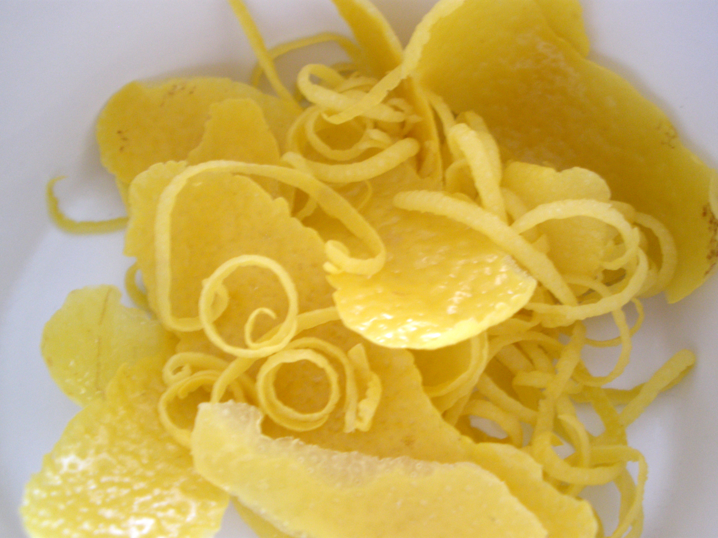
bigal_60714, https://www.flickr.com/photos/alejandraowens/5365303225/sizes/o/
Notes:
bigal_60714
https://www.flickr.com/photos/alejandraowens/5365303225/sizes/o/

Slide 29
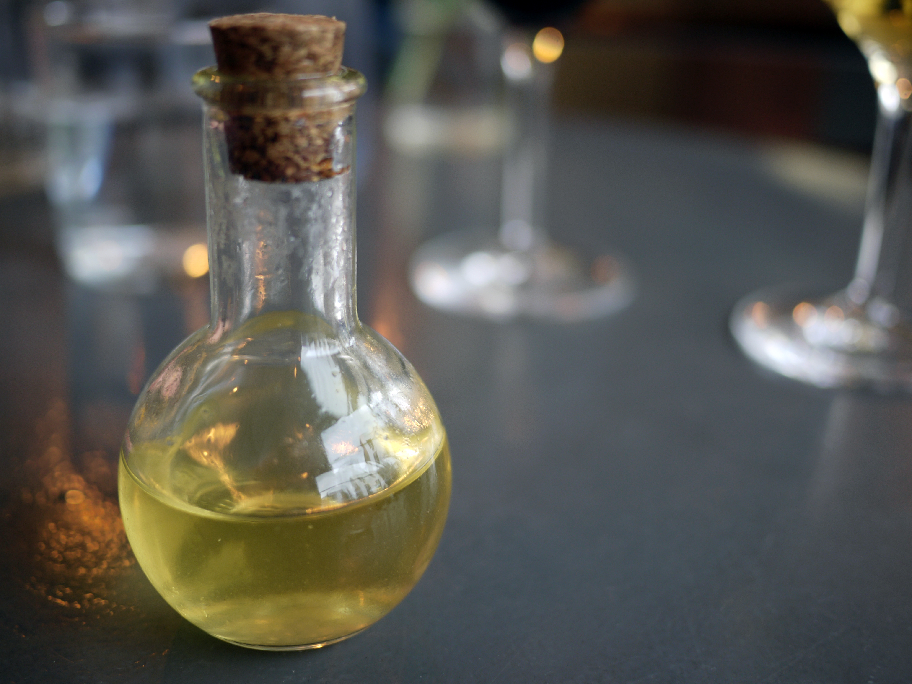
Pidgin lemoncello, Chris Pople, https://c1.staticflickr.com/5/4176/33805510234_31b932962b_o_d.jpg
Notes:
Pidgin lemoncello
https://c1.staticflickr.com/5/4176/33805510234_31b932962b_o_d.jpg
Chris Pople
https://www.flickr.com/photos/60173925@N06/

Slide 30
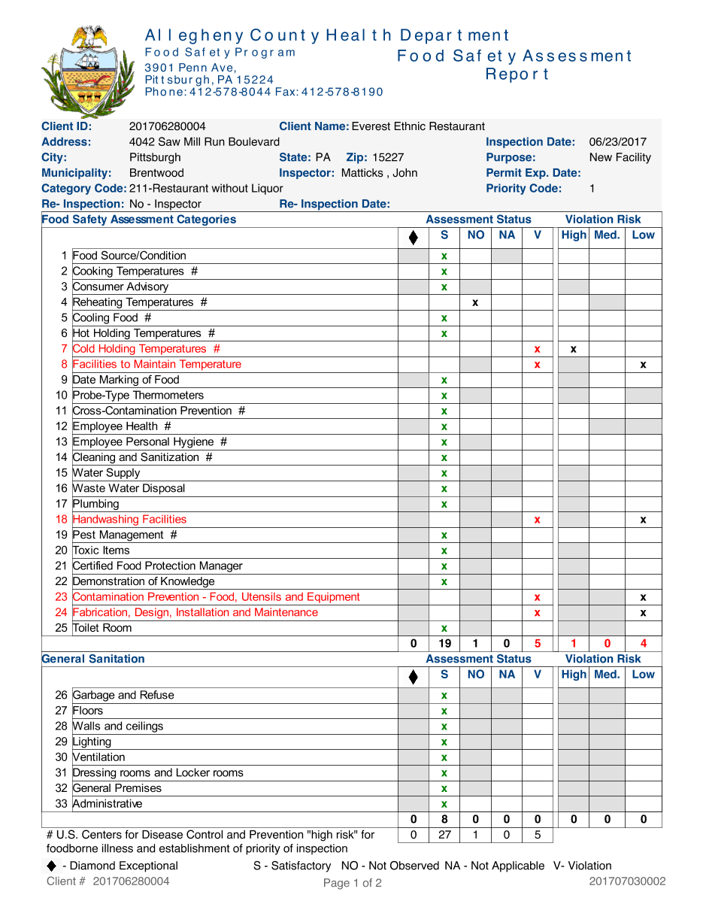
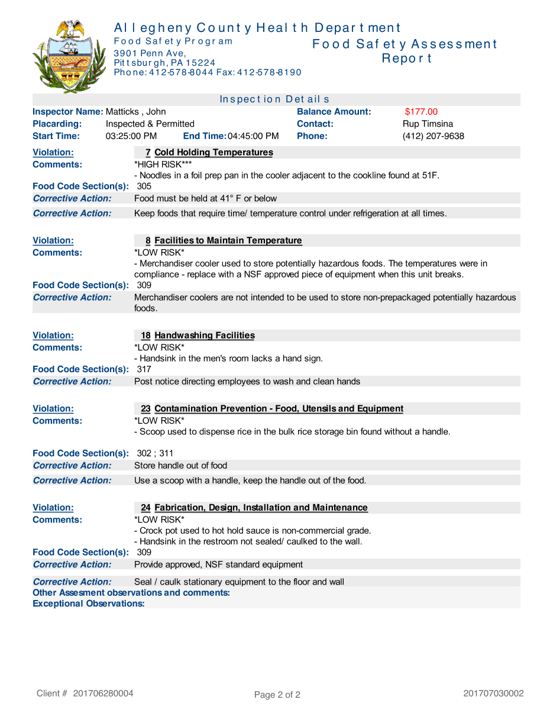
PDF is data
Notes:
201707030002, http://appsrv.achd.net/reports/rwservlet?food_rep_insp&P_ENCOUNTER=201707030002

Slide 31
PDF is data
Notes:
201707030002, http://appsrv.achd.net/reports/rwservlet?food_rep_insp&P_ENCOUNTER=201707030002

Slide 32
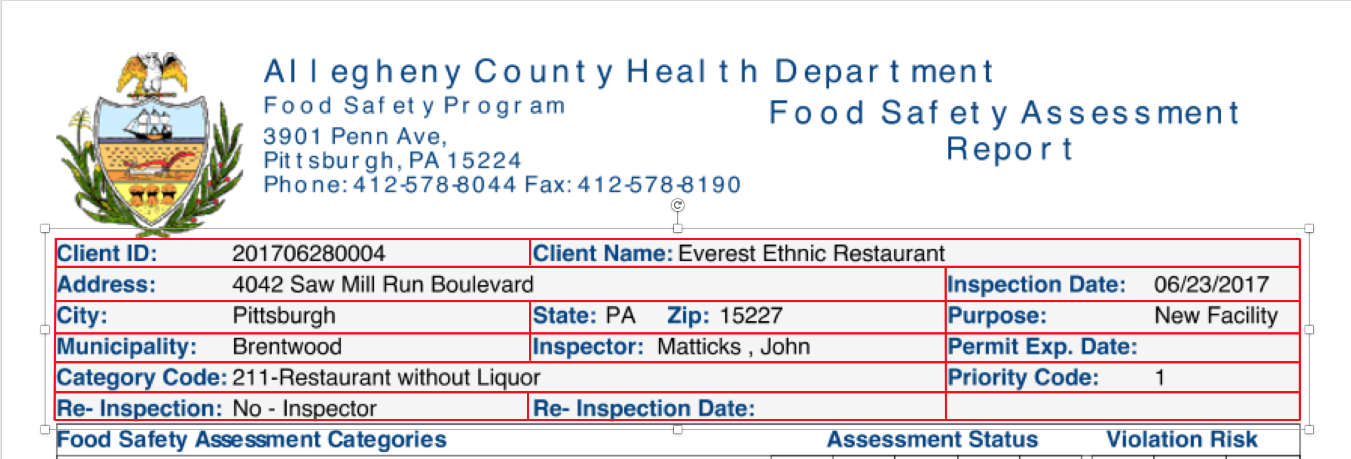

Slide 33
Show Some Code
PDF File
Identify A Page
Text Stripper
Define Regions
Create Regions
Name Regions
Review and revise

Slide 34
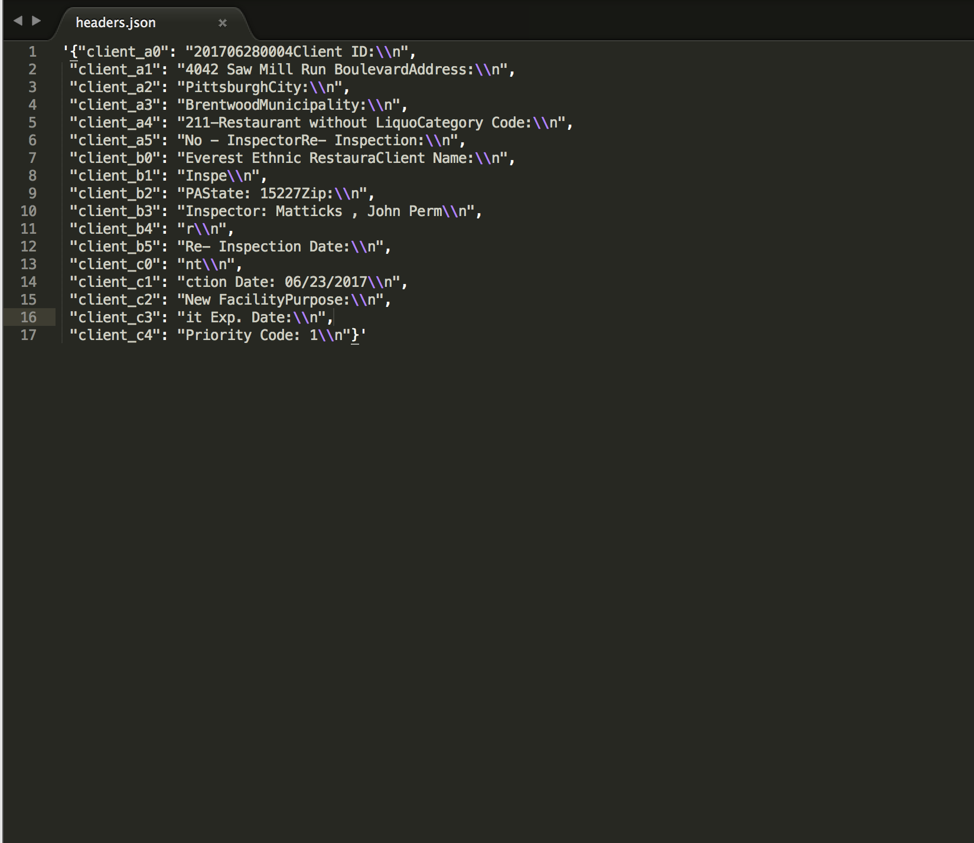

Slide 35
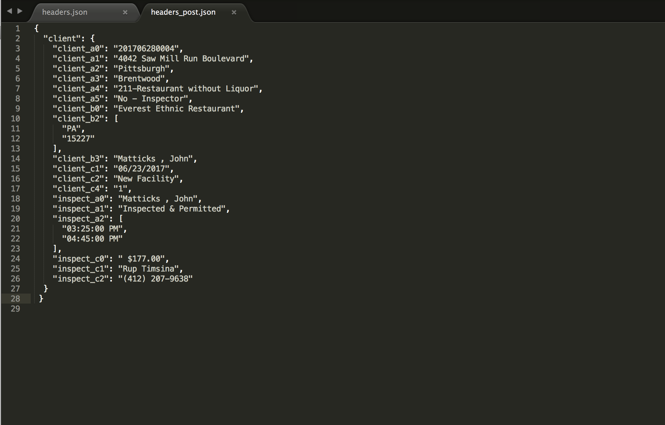

Slide 36
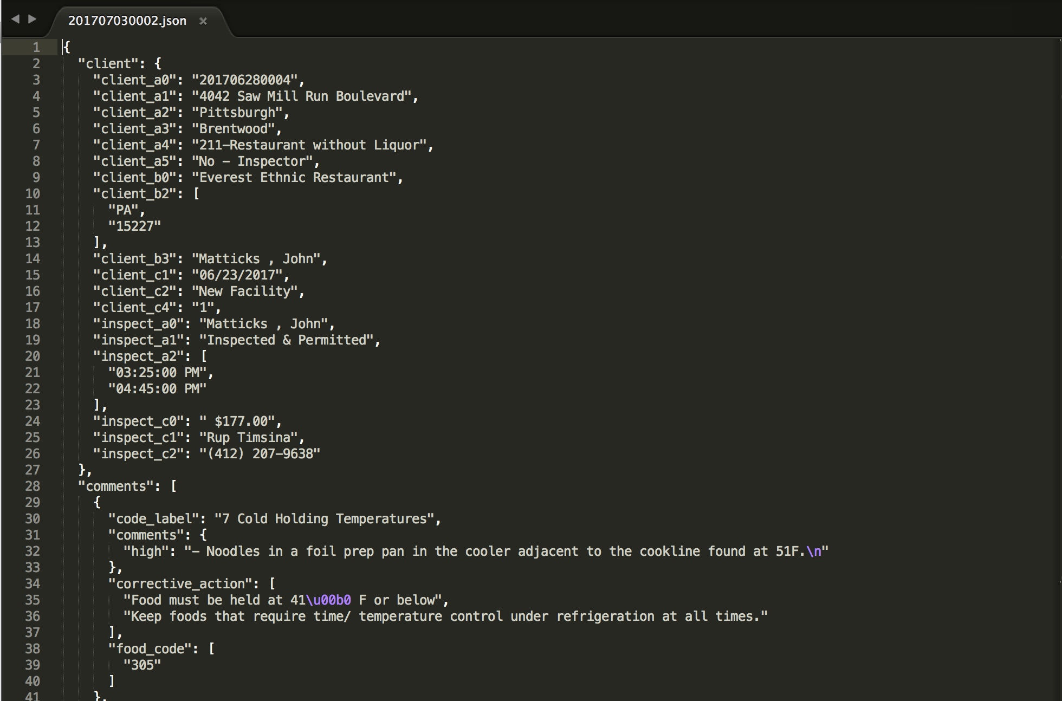
Notes:
http://remix.epiccry.com/json/201707030002

Slide 37
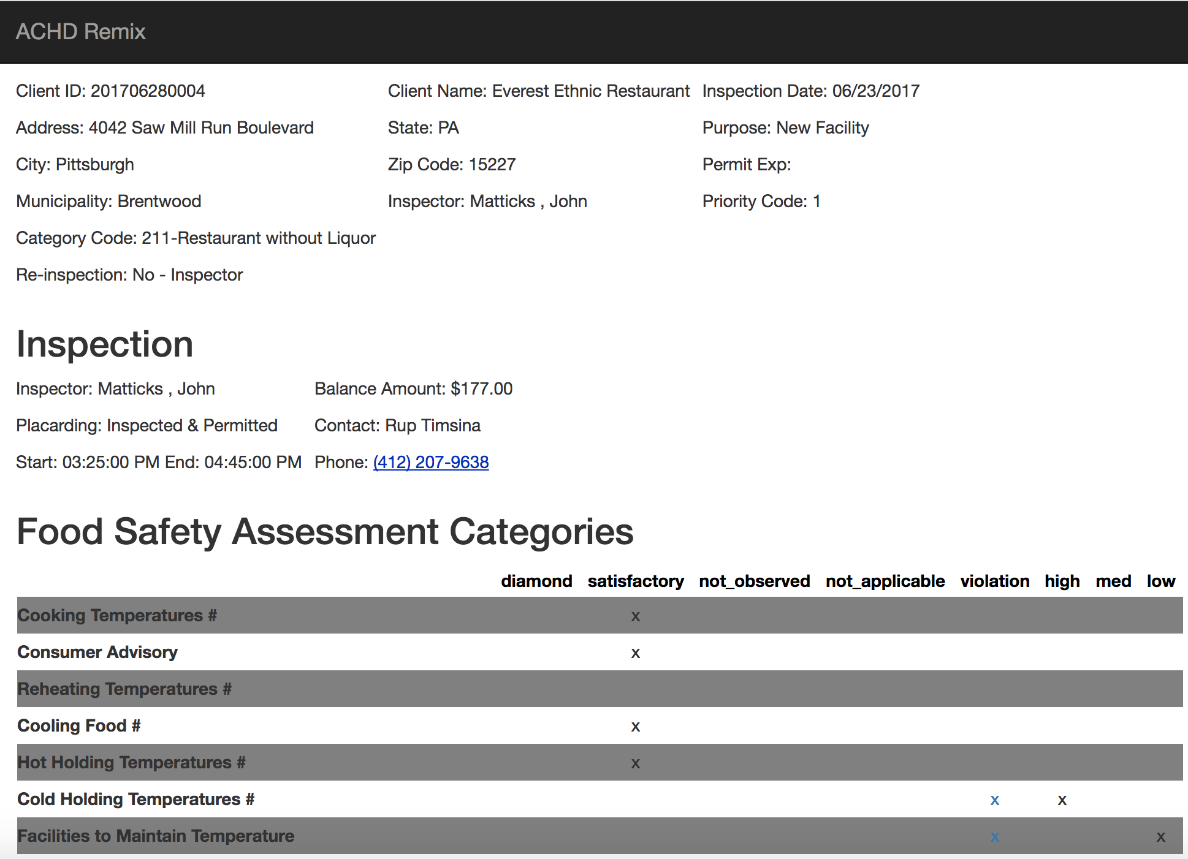
Notes:
http://remix.epiccry.com/inspection/201707030002

Slide 38
Complex Text Extraction
We didn’t need delimiters.
We needed to recognize header values.
We made retained context.
The top half and the bottom half issue was solved with human intelligence

Slide 39
PDFTabExtract

Slide 41
PDFTabExtract
Evaluation – So, So – your use case must match the tool tightly
Complexity – High, very complex
Human or Machine – Either, but complex

Slide 42
Very Specific Use Criteria
Must have a sandwich PDF
Must have an image in the upper left-hand corner
Must have gridlines so that OpenCV can recognize the orientation
Must use poppler tools to get XML with coordinates
If not a “ Sandwich PDF ” , Use Tesseract as OCR Tool
Tesseract is powerful, but more complicated than setting up Jython

Slide 43
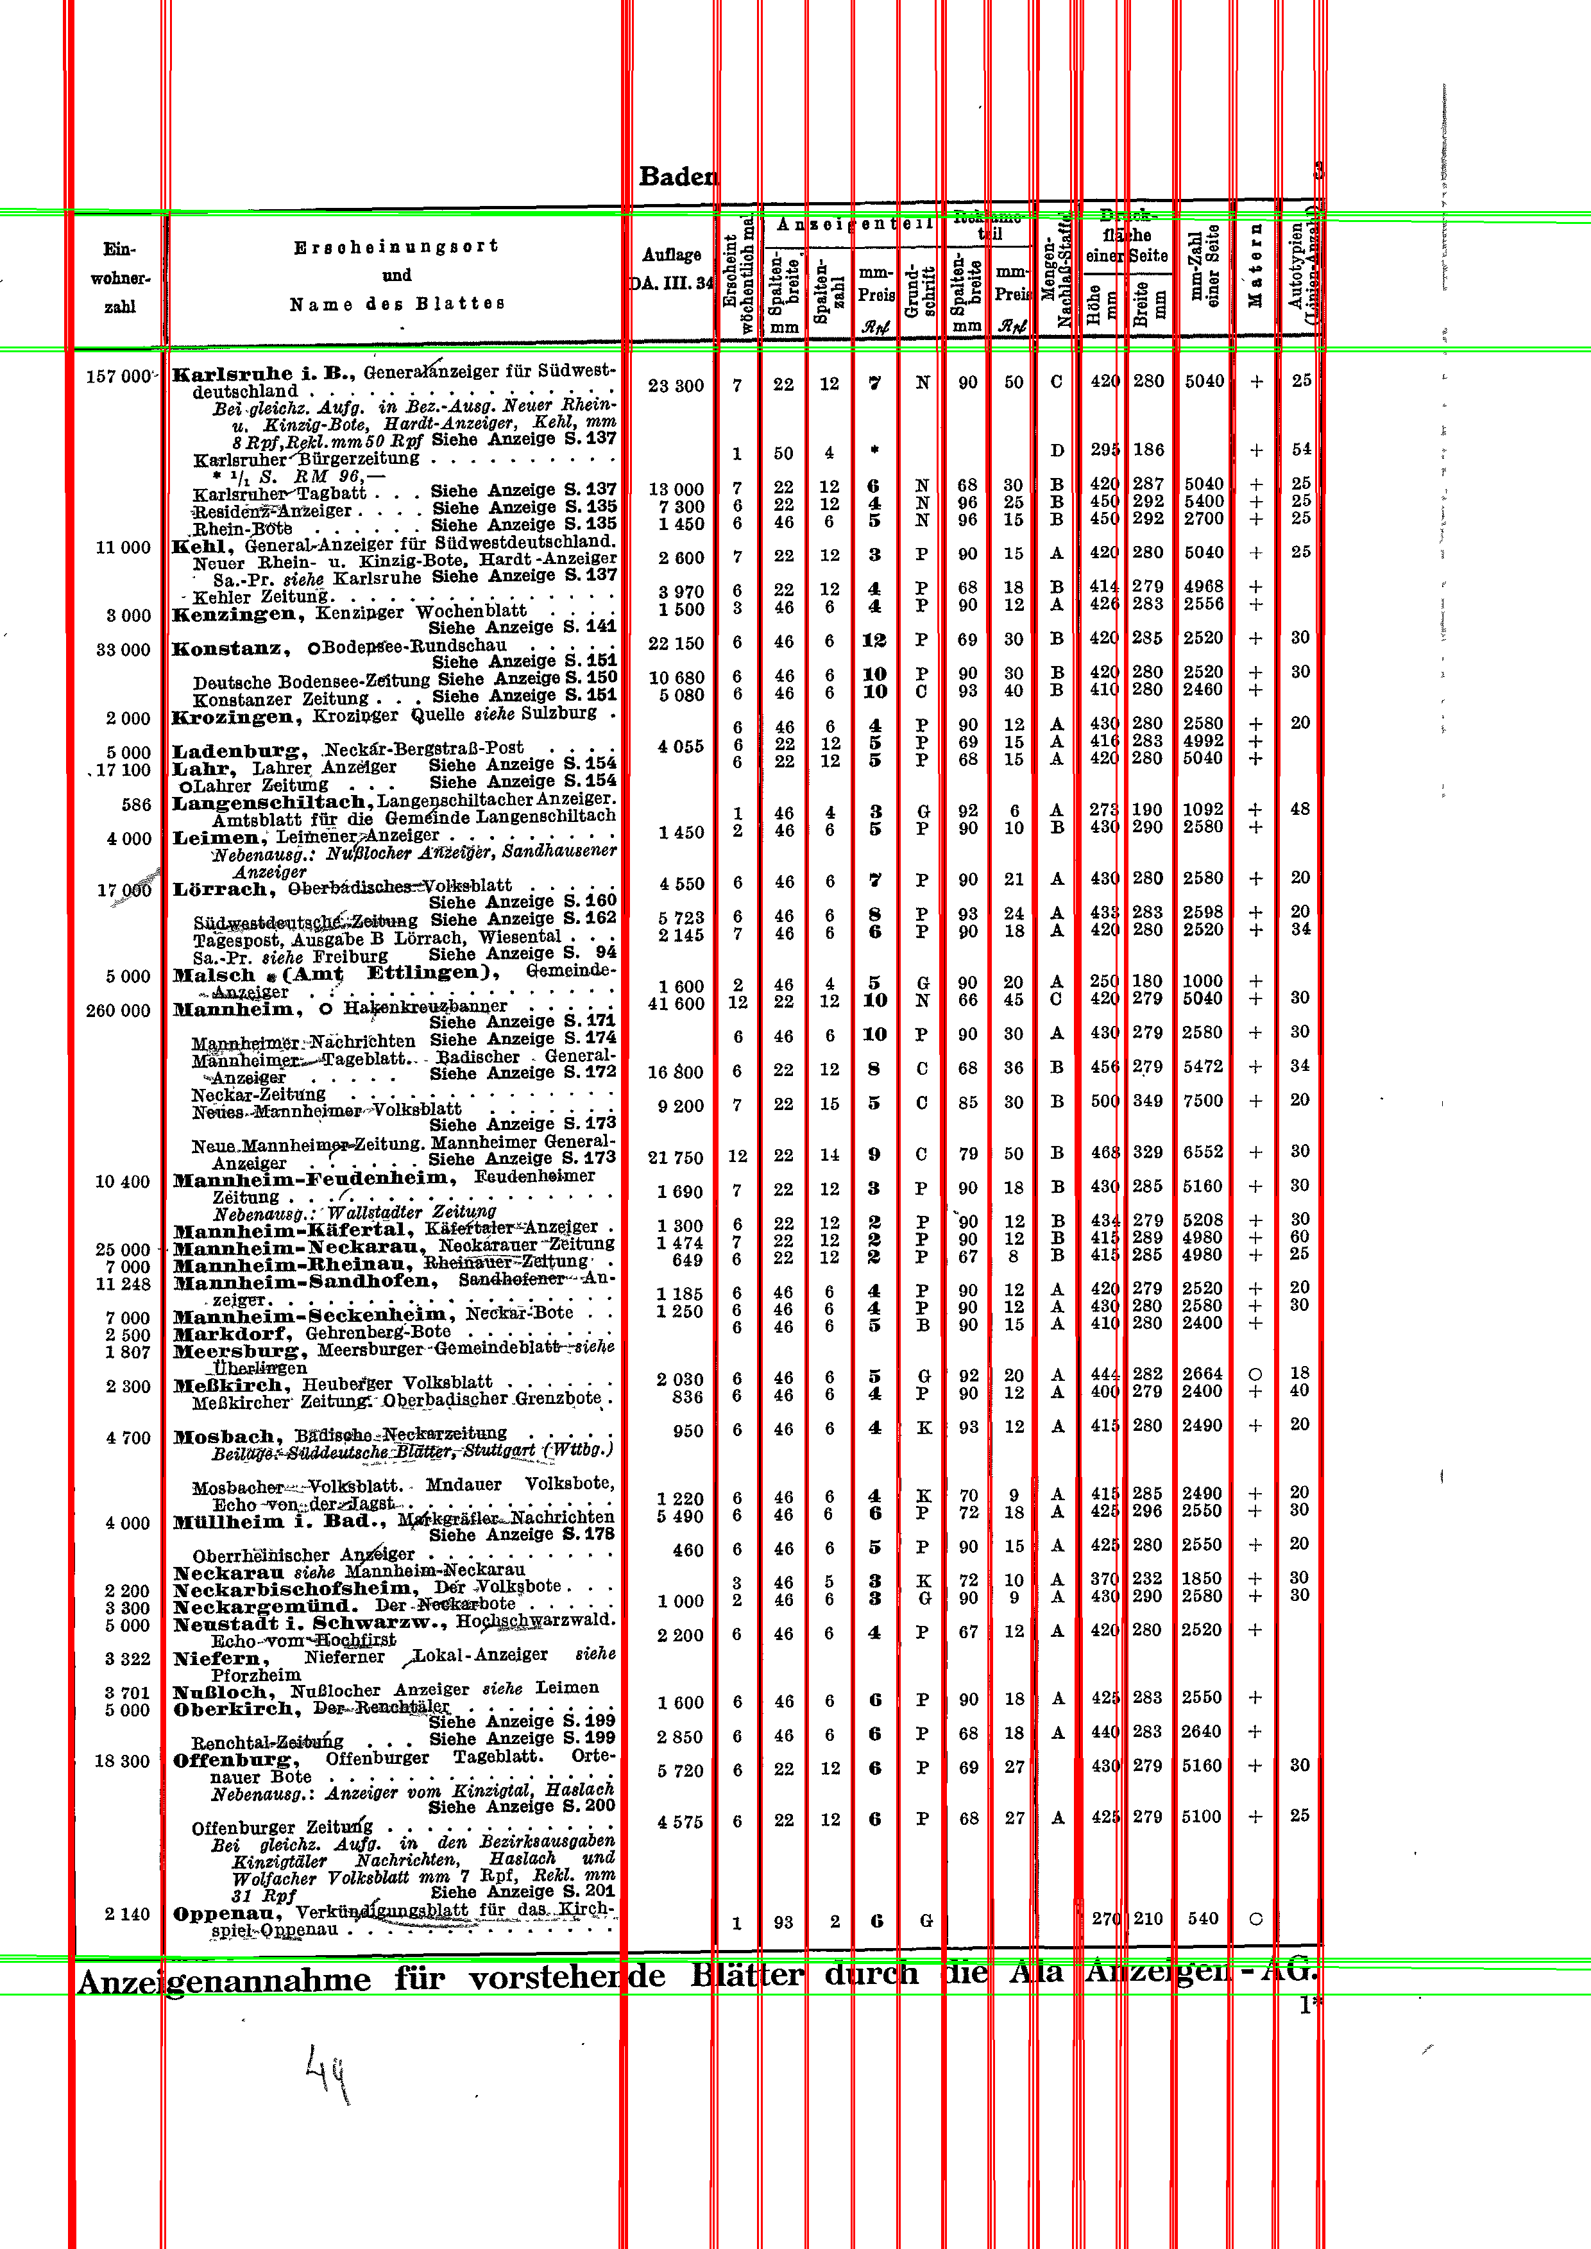
Tutorial Example Document

Slide 44
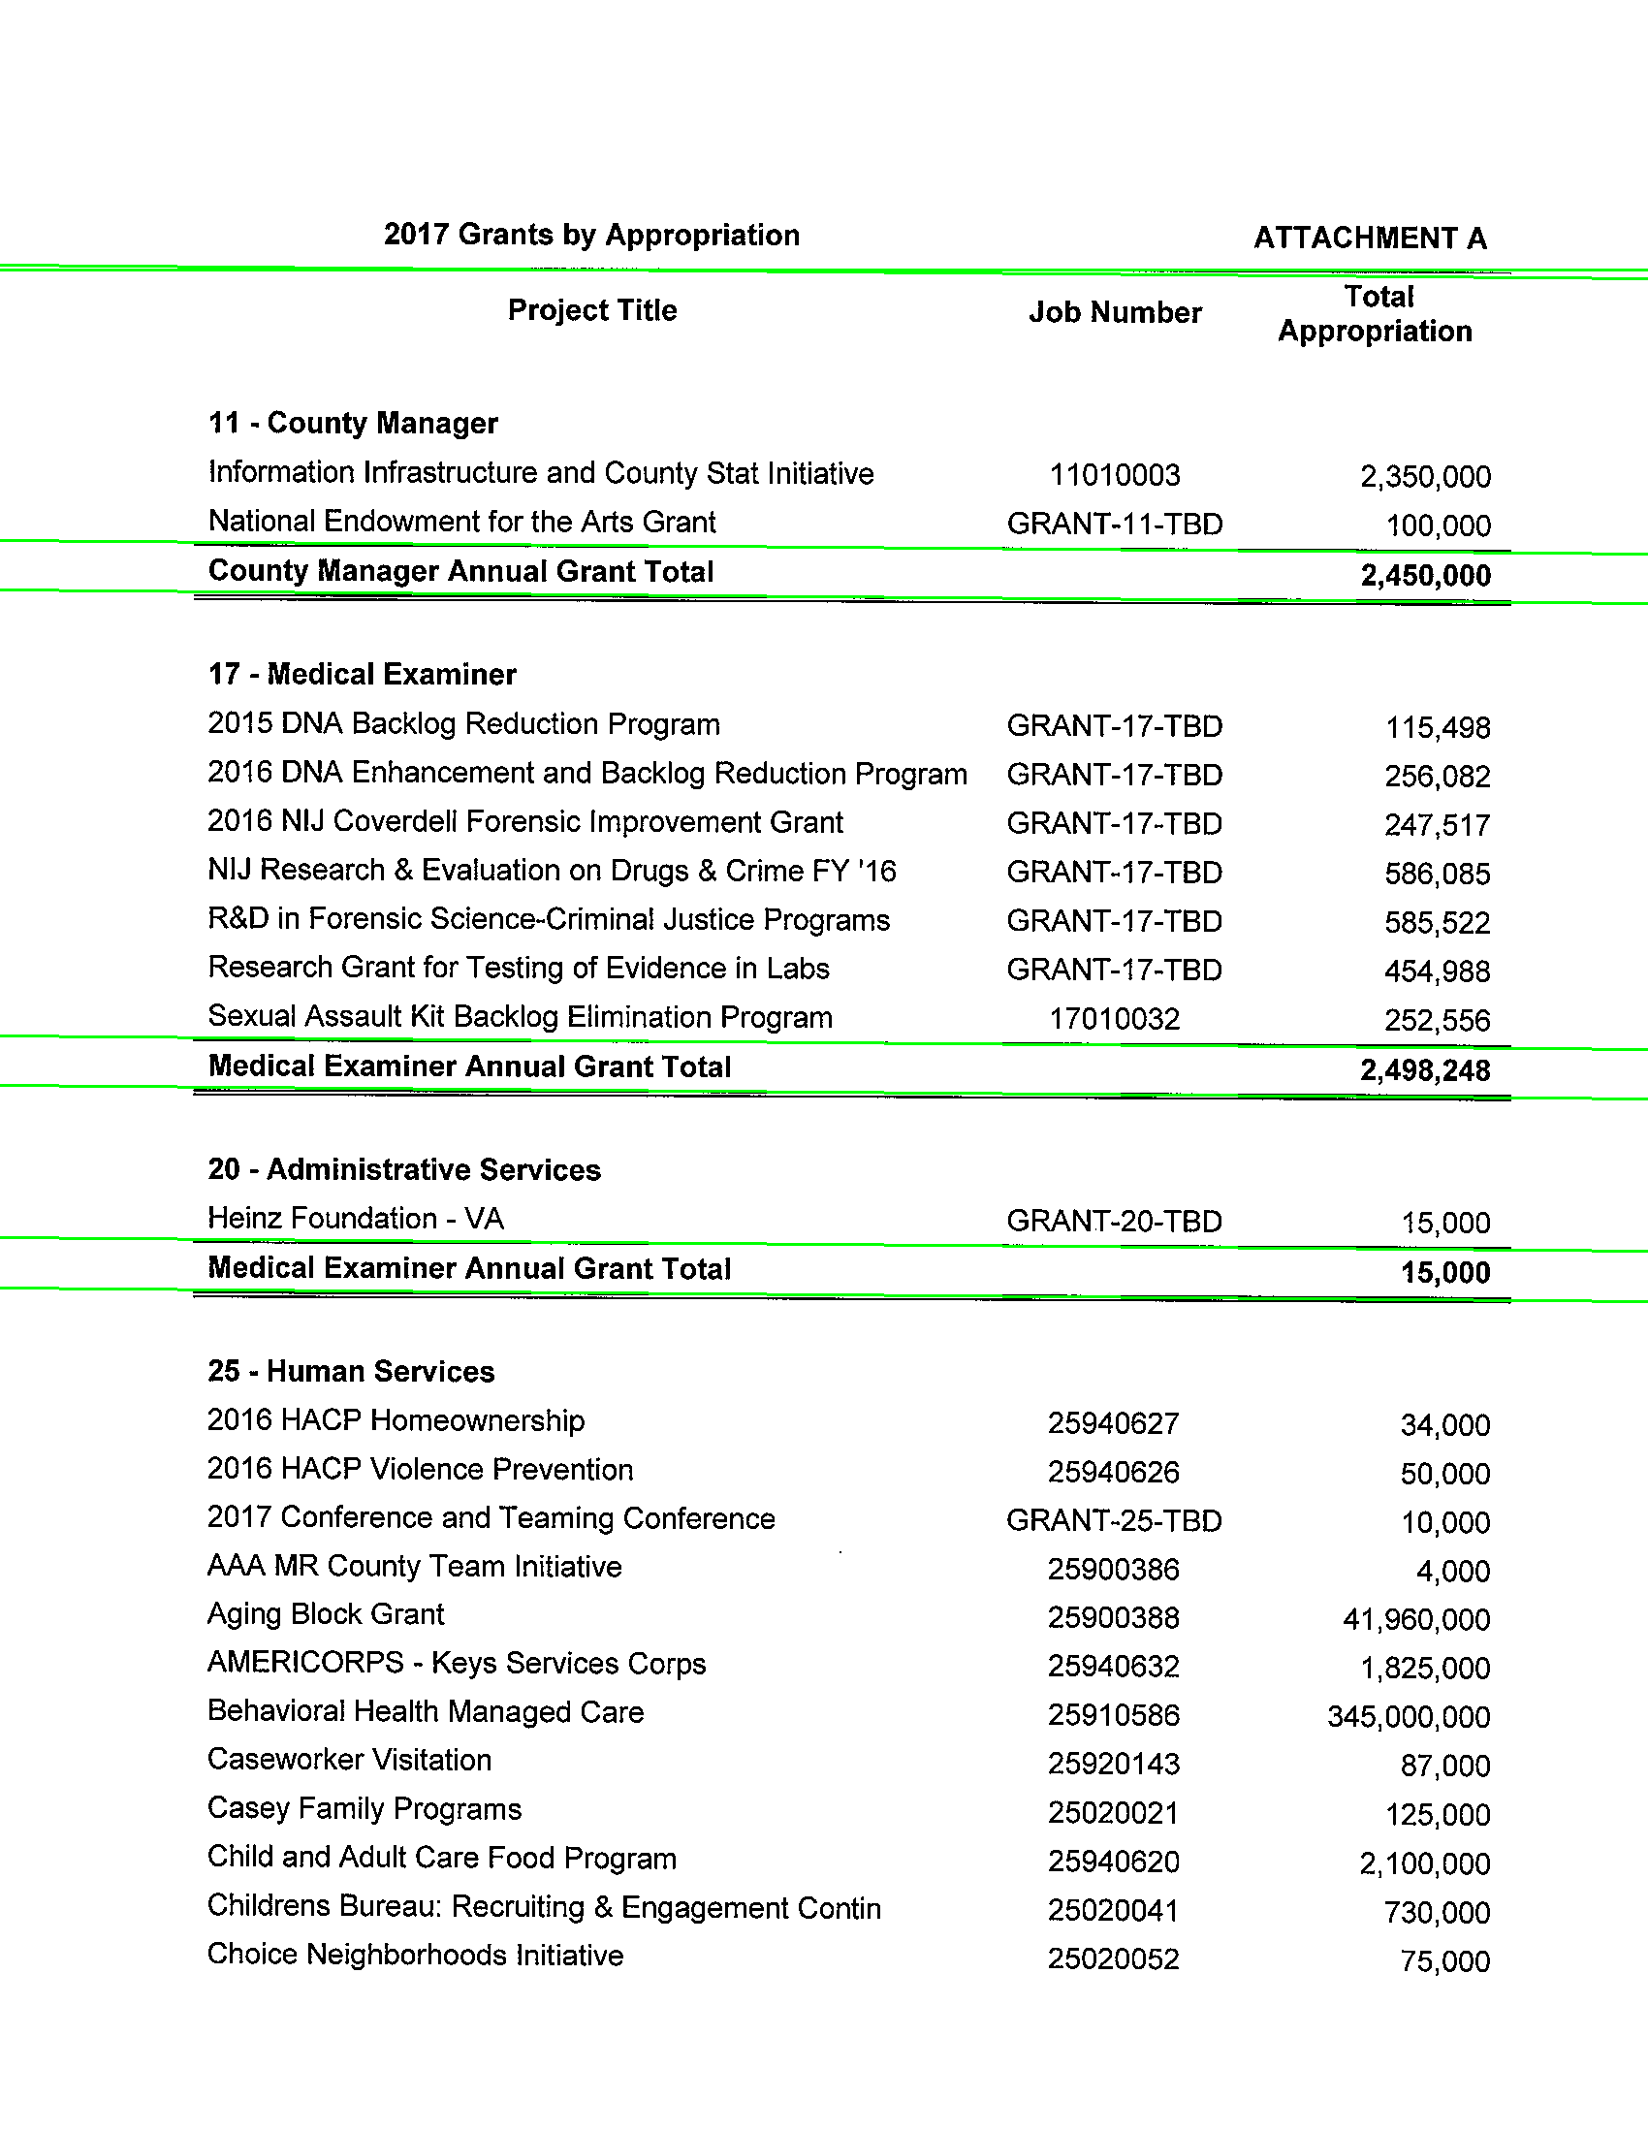
My Example Document
Notes:
This Slide Contains Sensitive Material

Slide 45
This was a pipeline issue
This library needs to fit your problem very well
It leaves out a lot of the pipeline issues
Tesseract
Poppler Utils
OpenCv
It’s interesting, but complicated

Slide 46
PANAMA PAPERS
Notes:
Lemon
honor the gift
https://www.flickr.com/photos/honorthegift/5080575540/sizes/o/

Slide 47
Notes:
PM of Pakistan visits Downing Street
https://www.flickr.com/photos/number10gov/
https://www.flickr.com/photos/number10gov/14094086173/sizes/l/

Slide 48

Notes:
Stjórnarráð Íslands
https://www.flickr.com/photos/stjr/
License All rights reserved by
https://www.flickr.com/photos/stjr/22370055709/sizes/k/

Slide 49
International Consortium for Investigative Journalists (ICIJ)
https://source.opennews.org/articles/people-and-tech-behind-panama-papers/
A tool built on past success – 3 years in the making
Apache Solr
Apache Tika
Tesseract
Downfall of World Leaders
Nawaz Sharif – Former Prime Minister of Pakistan
Sigmundur David Gunnlaugsson – Former Prime Minister of Iceland
Extract on GitHub
https://github.com/ICIJ/extract
Notes:
https://www.nytimes.com/2017/07/28/world/asia/panama-papers-pakistan-nawaz-sharif.html?rref=collection%2Ftimestopic%2FPakistan&action=click&contentCollection=world&region=stream&module=stream_unit&version=latest&contentPlacement=1&pgtype=collection
https://source.opennews.org/articles/people-and-tech-behind-panama-papers/
https://github.com/ICIJ/extract

Slide 50
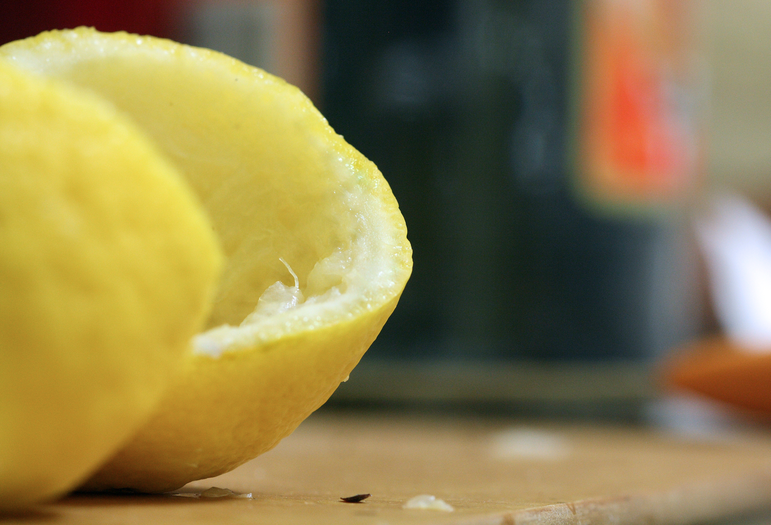
Notes:
Lemon Rind
https://www.flickr.com/photos/8476316@N03/
https://www.flickr.com/photos/8476316@N03/4679070922/sizes/o/

Slide 51
Concluding Remarks
PDF is Data
Make them accessible
This isn’t a library quite yet

Slide 52
Resources
github.com/kdurril/pdftherobustway
Tika - tika.apache.org/
PDFBox - pdfbox.apache.org
PDFTabExtract - github.com/WZBSocialScienceCenter/pdftabextract
Jython - www.jython.org/
Poppler Utils
Tesseract
Notes:
remix.epiccry.com
http://www.openrecords.pa.gov/Appeals/FinalDetRecord.cfm?docket=2011-0467
http://www.achd.net/board/pubs/minutes/050411_boh_minutes.pdf

Slide 53
Fin
Kenneth Durril
@kennetd
github.com/kdurril/pdftherobustway
remix.epiccry.com
github.com/kdurril/achd2x

Slide 54
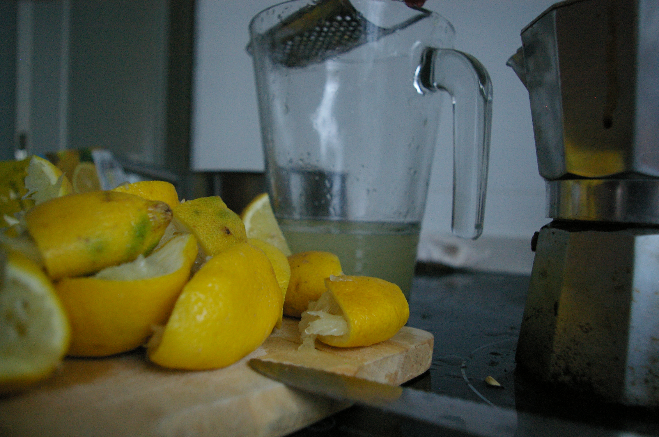
Notes:
Lemon Graveyard
https://www.flickr.com/photos/speculummundi/4823168477/sizes/o/
https://www.flickr.com/photos/speculummundi/

Slide 55
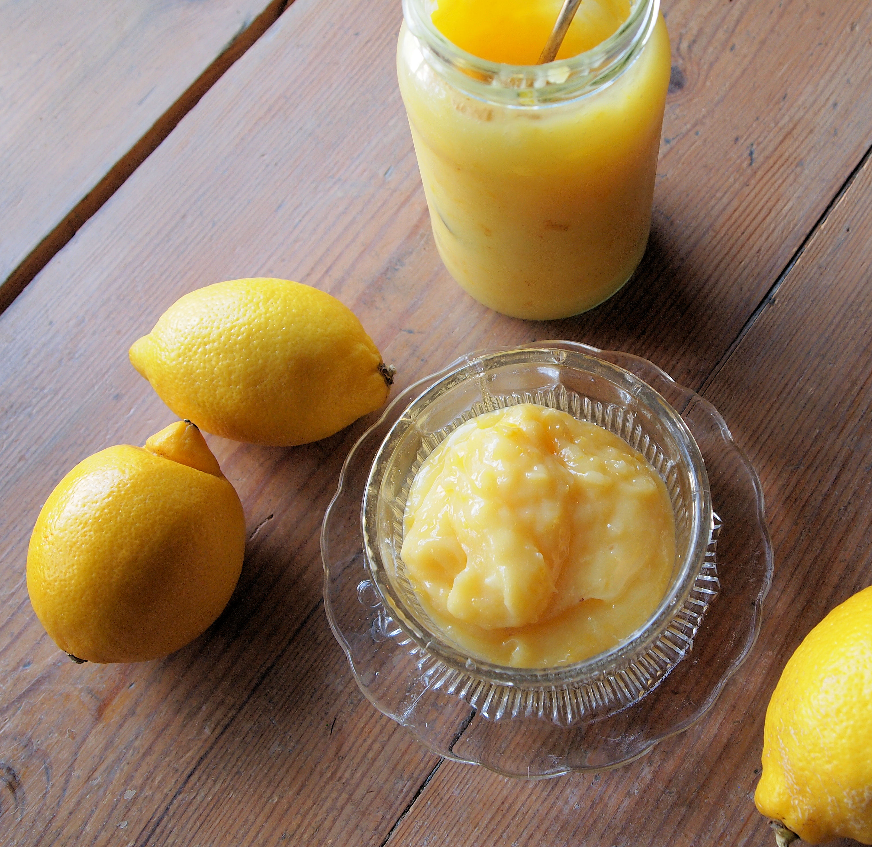
Notes:
Zingy Home-made lemon curd
French Tart
https://www.flickr.com/photos/frenchtart/5483243968/sizes/o/

Slide 56
Notes:
Pidgin lemoncello
https://c1.staticflickr.com/5/4176/33805510234_31b932962b_o_d.jpg
Chris Pople
https://www.flickr.com/photos/60173925@N06/

Slide 57
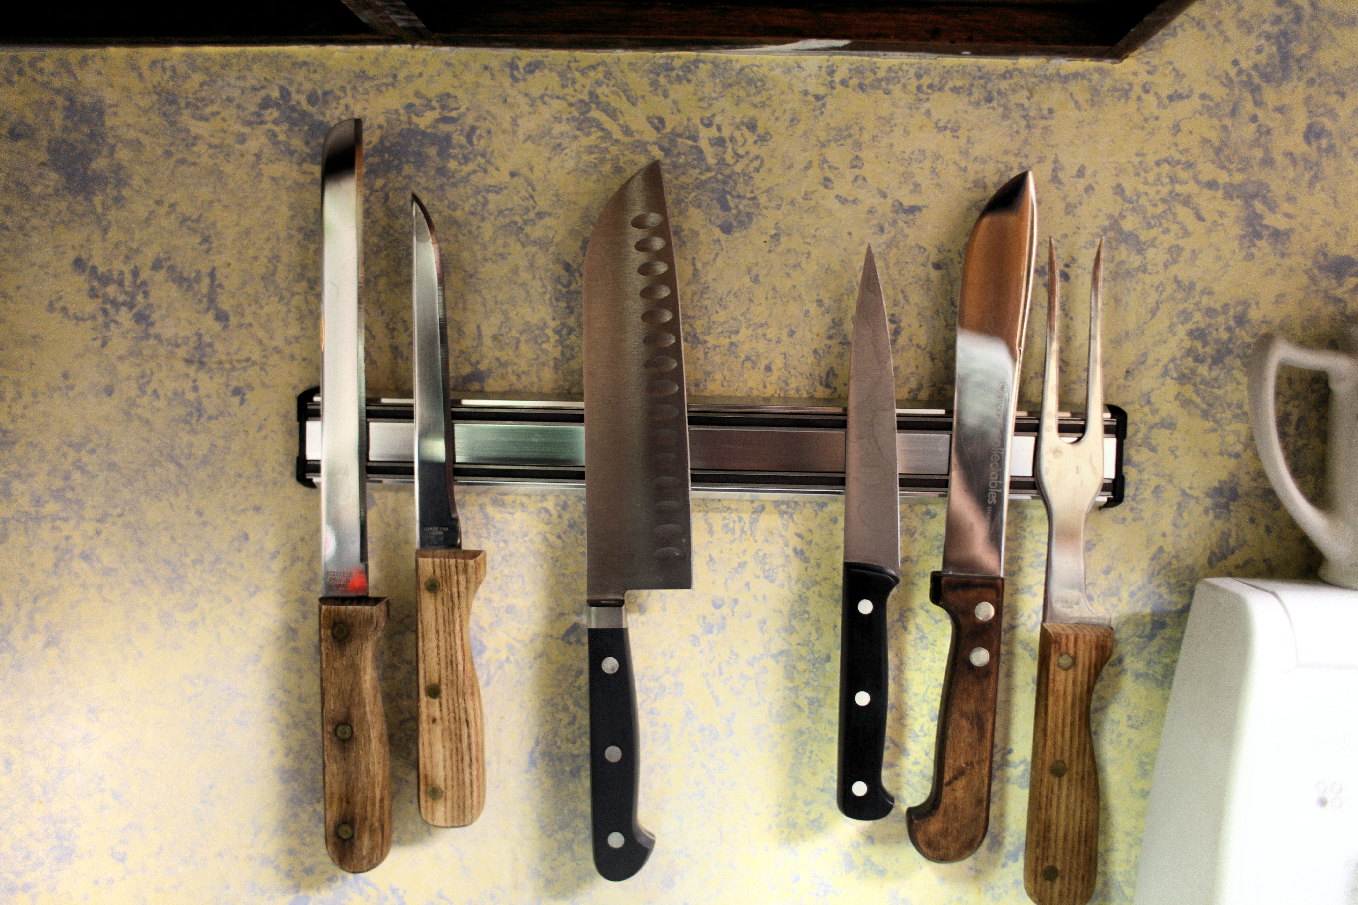

Slide 58
Notes:
Nov 17 - CN - DC - Strawberries 2
USDAgov
https://www.flickr.com/photos/usdagov/15844937015/sizes/o/

Slide 59
Notes:
20111012-FNCS-LSC-0260 by USDepartment of Agriculture
https://www.flickr.com/photos/usdagov/6239460604/sizes/o/
Nov 17 - CN - DC - Strawberries 2 by USDepartment of Agriculture
https://www.flickr.com/photos/usdagov/15844937015/sizes/o/

